Slide 1
3D Interactive Media Development
5MMCS001W Lecture 04

Slide 2
3D Interactive Media Development
3DUI Interaction Practical examples – web
100,000 Stars – Google VR experiment
http://stars.chromeexperiments.com/
Starts with mouse orbit like whitevoid, inertia, Music
Like Eames degrees
Restricted to Solar system as focus.
3DUI:
Slider Bar – Scrolling (We could have control for exploded view)
Waypoints
Mouse Orbit
Labels
Zoom out
Cursor lock, switch
Idle animations
Ease-ins, outs, Fade-ins, outs

Slide 3
CW Overview and Recap

Slide 4
CW Scope – 3DUI, 3DVE
3D Content Creation/Production Software
3D World Representation with Navigation and Transformation
2D/3D Input Devices and Paradigms
2D/3D UI Concepts and Research
3D Platforms

Slide 5
3DUI CW Framework – Concepts
Lego Based Construction
Mecabricks – use to make variety for builds
Minifigs with Animation – will be given one.
VE Perceptual Structure/Navigation
Exploded View or 3D or 2.5D Diorama
Waypoint/Mouse Orbit or 3rd Person Navigation
VE Interaction – Selection/Manipulation
HUD, 2D Menu in 3D World
2D Input control of Object/3D Object Widget (on screen joypad)
State changes by Keyboard/Menu
Collision Triggering
System Control – Animation
Animation Triggering
Narrative Animation
Scripted movement control

Slide 6
3DUI CW Framework – Elements
Elements:
Navigation
Interaction
System Control

Slide 7
3DUI CW Framework - Platform
Framework for Module:
Inputs – Mouse, Keyboard
Software/Hardware Platform - Desktop
Output –2D Screen Display
This is plenty complex to explore the wide range of choice just for these. We will develop 3D Interaction via 2D manipulation of a 3D environment. We might use a 3D Widget for direct object manipulation as a stretch target, or do touch input and widgets for android, or Accelerometer and 360 video with 3DUI

Slide 8
3DUI CW Framework – 3D Interaction
So…
2D Manipulation of 3D
(2D Input Devices with Direct Mappings to 3D)
3D Manipulation of 3D
(3D Input Devices)
Razer Hydra – 3D Facebook
Immersive 3D with PUI
Brenda Laurel
3D Input

Slide 9
CW 3D Interaction Techniques
3D UI: 3D interaction Widgets.
2D HUD on 3D POV
2D Menu on 3D POV
2D Menu within 3D VE
2D mouse selection of button for 3D Interaction
2D mouse direct control of object
2D mouse direct control of 3D Gimbal/Widget for object
2D and 3D Collision
3D Natural Input and 3D direct control of objects

Slide 10
3DUI CW Framework – HCI
Goals:
Reduce Cognitive Load
Enhance Spatial Knowledge
Ease of Use
Manage Elements to Achieve Goals:
Control to Task Mapping
Perceptual Structure
Motor Coordination

Slide 11
3DUI CW Framework – Software
Module Supported Framework:
3DS Max
Modelling
Texturing
Animation
Unity3D
Input Navigation
3D UI Interaction/ Movement Scripting
Animation Triggering / Narrative Animation
State Control
Shaders and Lighting
WebGL Build
Output
Mouse and Keyboard Control

Slide 12
CW1 Group Report Outline

Slide 13
Module Scope – Working Practice
System Design and Implementation:
Define Problem or Narrative to Convey (3.2.2)
Deploy Theory in Design and Implementation (2.1.5)
Deploy Software and Hardware Tools Effectively (2.2.4)
Deploy Systems to meet Commercial Goal (3.1.1)

Slide 14
3DUI CW 1 (Group)
3. Planning for CW2 3DUI Interactivity Report (Group Presentation, 1 per group)
a. Concept and Design

Slide 15
3DUI CW 1 (Group)
3. Planning for CW2 3DUI Interactivity Report (Group Presentation, 1 per group)
b. Design Diagrams

Slide 16
Module Scope Architecture
Model View Controller
Software architecture for GUIs
Diagrams
Use Case Diagram http://casecomplete.com/learn
Storyboard – Views
Domain/Class Diagram
https://en.wikipedia.org/wiki/Class_diagram

Slide 17
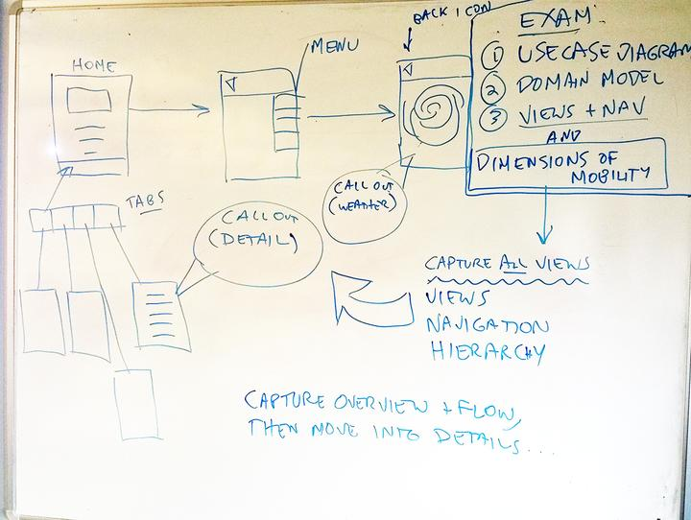
3DUI CW 1
StoryBoard/Flowchart
Views
Navigation
Hierarchy
Tabs
Menus
Call-Outs
(Detail)
Overview
Flow
Details
This is
Almost
MVC – Model View Controller (Later)

Slide 18
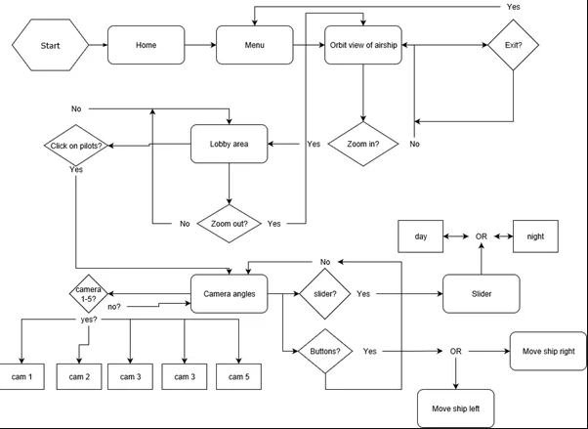
3DUI CW 1
StoryBoard/Flowchart
Views
Navigation
Hierarchy
Tabs
Menus
Call-Outs
(Detail)
Overview
Flow
Details
This is
Almost
MVC – Model View Controller (Later)

Slide 19
3DUI CW 1
Use Case Diagram
Casecomplete
https://casecomplete.com/
http://astah.net/
Defines:
Product context and boundaries
Overview of apps required functionality and overall use scenario using Actor (Stakeholder or end user)
Document Models of Key Aspects of your App
The required Functionality of your project

Slide 20
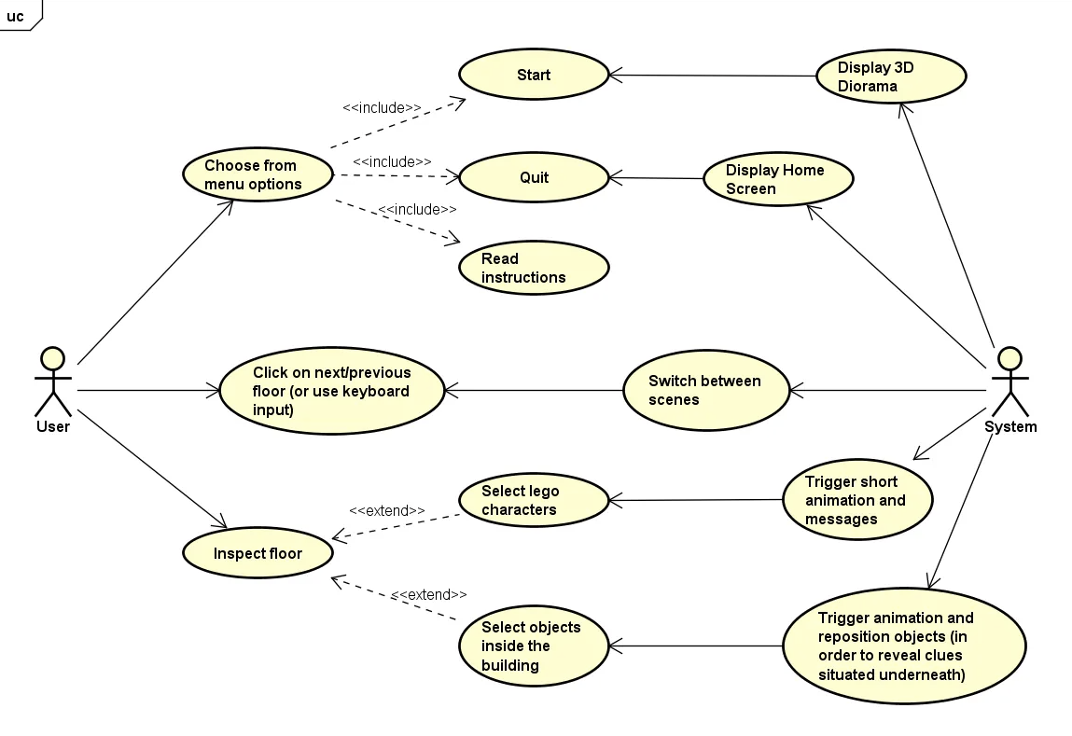
3DUI CW 1
Use Case Diagram

Slide 21
3DUI CW 1
Use Case Diagram
http://creately.com/blog/diagrams/use-case-diagram-relationships/
Relationship types
Association between actor and use case
Generalization of an actor
Extend between two use cases
Include between two use cases
Generalization of a use case

Slide 22
3DUI CW 1
Use Case Diagram
http://creately.com/blog/diagrams/use-case-diagram-relationships/ The <<include>> relationship represents a mandatory part of a use case's workflow, where one use case's behavior is always included in another. In contrast, the <<extend>> relationship signifies optional behavior that adds functionality to a base use case under specific conditions.
Includes
The base use case is incomplete without the included use case.
The included use case is mandatory and not optional.
Extends
The extending use case is dependent on the extended (base) use case.
The extending use case is usually optional and can be triggered conditionally.
In the diagram you can see that the extending use case is triggered only for deposits over 10,000 or when the age is over 55.
The extended (base) use case must be meaningful on its own. This means it - base use case should be independent and must not rely on the behavior of the extending use case.

Slide 23
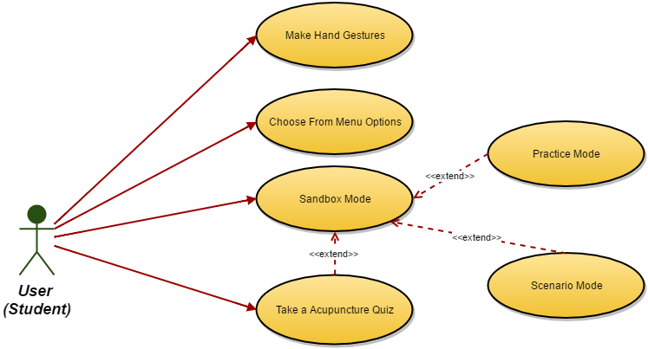
3DUI CW 1
Use Case Diagram Acupuncture
Casecomplete
http://astah.net/

Slide 24
3DUI CW 1
Use Case Diagram
http://creately.com/blog/diagrams/use-case-diagram-relationships/
Think about an Example for 10000 Stars

Slide 25
3DUI CW 1
Domain Model/Class Diagram
Domain model (class diagram)
https://en.wikipedia.org/wiki/Class_diagram
Entities
Need
Classes
Associations - labelled
Aggregation - yes (maybe composition)
Multiplicity
Attributes- not strictly needed
some methods

Slide 26
3DUI CW 1
Domain Model/Class Diagram – Model, View, Controller
A software architectural pattern for implementing user interfaces on computers. It divides a given software application into three interconnected parts, so as to separate internal representations of information from the ways that information is presented to or accepted from the user.
Traditionally used for desktop graphical user interfaces (GUIs), this architecture has become popular for designing web applications.
As with other software patterns, MVC expresses the "core of the solution" to a problem while allowing it to be adapted for each system.

Slide 27
3DUI CW 1
Domain Model/Class Diagram – Model, View, Controller
Components
The central component of MVC, the model, captures the behavior of the application in terms of its problem domain, independent of the user interface.
Model
The model directly manages the data, logic, and rules of the application.
View
A view can be any output representation of information, such as a chart or a diagram. Multiple views of the same information are possible, such as a bar chart for management and a tabular view for accountants.
Controller
The third part, the controller, accepts input and converts it to commands for the model or view.

Slide 28
3DUI CW 1
Domain Model/Class Diagram – Model, View, Controller
Interactions
In addition to dividing the application into three kinds of components, the model–view–controller design defines the interactions between them.
Model
A model stores data that is retrieved according to commands from the controller and displayed in the view.
View
A view generates new output to the user based on changes in the model.
Controller
A controller can send commands to the model to update the model's state (e.g., editing a document). It can also send commands to its associated view to change the view's presentation of the model (e.g., by scrolling through a document).

Slide 29
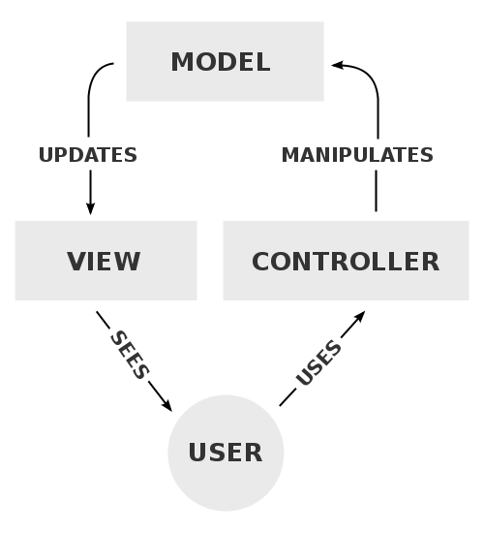
3DUI CW 1
Domain Model/Class Diagram – Model, View, Controller

Slide 30
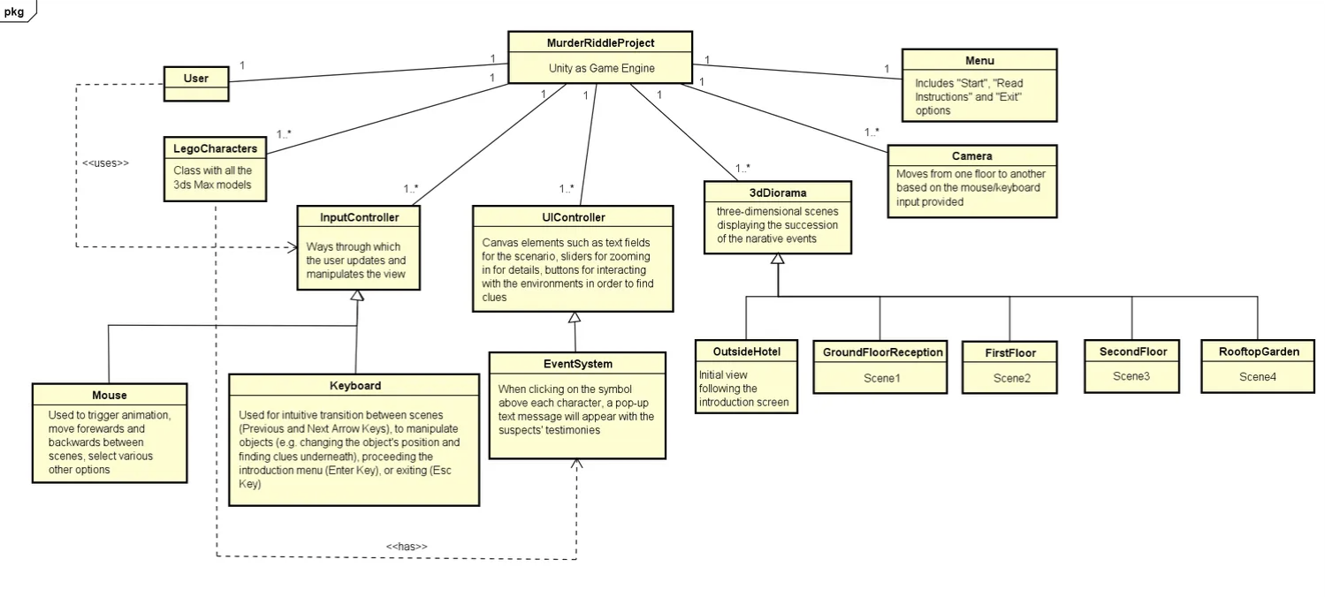
3DUI CW 1
Domain Model/Class Diagram Murder Riddle

Slide 31
3DUI CW 1
Domain Model/Class Diagram
https://en.wikipedia.org/wiki/Class_diagram
Think about an Example for 10000 Stars

Slide 32
3DUI CW 1
Diagrams Reference and Guides:
All Diagrams
http://astah.net/
http://casecomplete.com/learn
Class/Domain Diagrams
https://en.wikipedia.org/wiki/Class_diagram
Model View Controller
https://en.wikipedia.org/wiki/Model%E2%80%93view%E2%80%93controller

Slide 33
3DUI CW 1 (Group)
3. Planning for CW2 3DUI Interactivity Report (Group Presentation, 1 per group)
c. Project Management Methodology

Slide 34
Module Scope – Working Practice
Methodology:
Working, Management and Development Techniques to achieve objectives (2.1.8)
Peer Review, Group Work, Organisation (2.3.2)
Problem Solving Strategies and Methodology (2.1.3)

Slide 35
Module Scope Working Methodology
Some Examples:
Agile
Extreme Programming
Waterfall
Spiral
Incremental

Slide 36
Module Scope Working Methodology
Some Examples:
Agile
http://agilemethodology.org/
The Agile movement seeks alternatives to traditional project management. Agile approaches help teams respond to unpredictability through incremental, iterative work cadences and empirical feedback. Agilists propose alternatives to waterfall, or traditional sequential development.
Scrum emphasizes empirical feedback, team self management, and striving to build properly tested product increments within short iterations. Doing Scrum as it’s actually defined usually comes into conflict with existing habits at established non-Agile organizations.

Slide 37
Module Scope Working Methodology
Some Examples:
Agile
http://agilemethodology.org/
Individuals and interactions over processes and tools
Working software over comprehensive documentation
Customer collaboration over contract negotiation
Responding to change over following a plan

Slide 38
Module Scope Working Methodology
Some Examples:
Agile Scrum
http://www.collab.net/sites/default/files/uploads/CollabNet_scrumreferencecard.pdf
Scrum is the most popular way of introducing Agility due to its simplicity and flexibility.
Scrum emphasizes empirical feedback, team self management, and striving to build properly tested product increments within short iterations. Doing Scrum as it’s actually defined usually comes into conflict with existing habits at established non-Agile organizations.

Slide 39
Module Scope Working Methodology
Some Examples:
Simple Agile
http://agileforall.com/new-to-agile-keep-it-very-simple/
1.Collaborate – High Bandwidth Communication in Real Time
2. Work Together – Follows good communication – Pairing, Paired Programming
3. Honor Priorities – Work on Highest ranked priority story in Backlog for next iteration
4. Respect the Customer, Process, Product, Team, and Each Other
5. Do the simplest thing that works, then stop
6. Improve every iteration

Slide 40
Module Scope Working Methodology
Some Examples:
Waterfall
The Waterfall software development model has sequential and distinct phases. After completing each development phase, a milestone review should be conducted. The phases of the waterfall model are “requirements analysis and definition, system and software design, implementation and unit testing, integration and system testing, operation and maintenance” (Fairley, 2009). The development cycle can only move from one phase to the next after a milestone review is conducted.

Slide 41
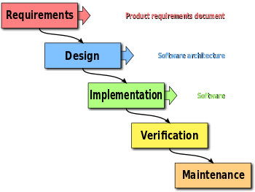
Module Scope Working Methodology
Some Examples:
Waterfall
The waterfall development model originates in the manufacturing and construction industries: highly structured physical environments in which after-the-fact changes are prohibitively costly, if not impossible. Because no formal software development methodologies existed at the time, this hardware-oriented model was simply adapted for software development.

Slide 42
Module Scope Working Methodology
Some Examples:
Waterfall
The disadvantage of the Waterfall model is that this model ignores any requirements or needs that may change as the product is being developed. By using this model, it can be difficult to make changes once the project is underway. The reasons for this limitation are the nature of the milestone reviews and the time taken between each one. Problems are caught at the milestones which may be too late. If the problems were detected earlier, they could have been fixed earlier in development (Fairley, 2009).

Slide 43
Module Scope Working Methodology
Some Examples:
Incremental
Another type of development model is the incremental model. Unlike the Waterfall model where the developer attempts to create the application in one attempt, Incremental development is fragmented into increments. This type of methodology prioritises the development of essential requirements in early increments.
After each increment is developed, the increment is tested and validated meaning that problems can be found earlier in the development cycle. As the code is developed, it may need rewriting and revalidating. This model allows the developer to “build-test-demonstrate’ progress (Fairley, 2009). Early increments can also act as prototypes that can be shown to stakeholders or used as a proof of concept .

Slide 44
Module Scope Working Methodology
Some Examples:
Incremental
Disadvantages of the incremental build happen when an excess amount of time is spent reworking increments. Another issue arises when the planned requirements are not developed in an increment (Fairley, 2009).

Slide 45
Module Scope Working Methodology
Some Examples:
Incremental – Iterative- Agile
Iterative - you don't finish a feature in one go. You are in a code >> get feedback >> code >> ... cycle. You keep iterating till done.
Incremental - you build as much as you need right now. You don't over-engineer or add flexibility unless the need is proven. When the need arises, you build on top of whatever already exists. (Note: differs from iterative in that you're adding new things.. vs refining something).
Agile - you are agile if you value the same things as listed in the agile manifesto. It also means that there is no standard template or checklist or procedure to "do agile". It doesn't overspecify.. it just states that you can use whatever practices you need to "be agile". Scrum, XP, Kanban are some of the more prescriptive 'agile' methodologies because they share the same set of values. Continuous and early feedback, frequent releases/demos, evolve design, etc.. hence they can be iterative and incremental.
https://stackoverflow.com/questions/11842318/difference-between-agile-and-iterative-and-incremental-development

Slide 46
Module Scope Working Methodology
Some Examples:
Spiral
The spiral model is a risk-driven process model generator for software projects. Based on the unique risk patterns of a given project, the spiral model guides a team to adopt elements of one or more process models, such as incremental, waterfall, or evolutionary prototyping).

Slide 47
Module Scope Working Methodology
Some Examples:
Spiral
Boehm lists these assumptions as follows:
The requirements are known in advance of implementation.
The requirements have no unresolved, high-risk implications, such as risks due to cost, schedule, performance, safety, security, user interfaces, organizational impacts, etc.
The nature of the requirements will not change very much during development or evolution.
The requirements are compatible with all the key system stakeholders’ expectations, including users, customer, developers, maintainers, and investors.
The right architecture for implementing the requirements is well understood.
There is enough calendar time to proceed sequentially.

Slide 48
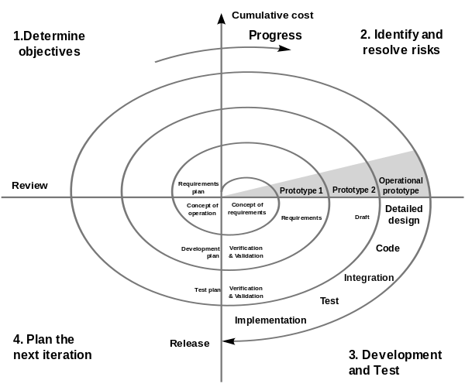
Module Scope Working Methodology

Slide 49
3DUI CW 1 (Group)
3. Planning for CW2 3DUI Interactivity Report (Group Presentation, 1 per group)
d. Commercial Analysis

Slide 50
Module Scope – Working Practice
System/Commercial Analysis:
Analyse current and future requirements for system (2.1.4)
Deploy Theory in Evaluation (2.1.5)
Analyse Commercial Issues (2.1.7)
Evaluate outcomes (4.2.2)

Slide 51
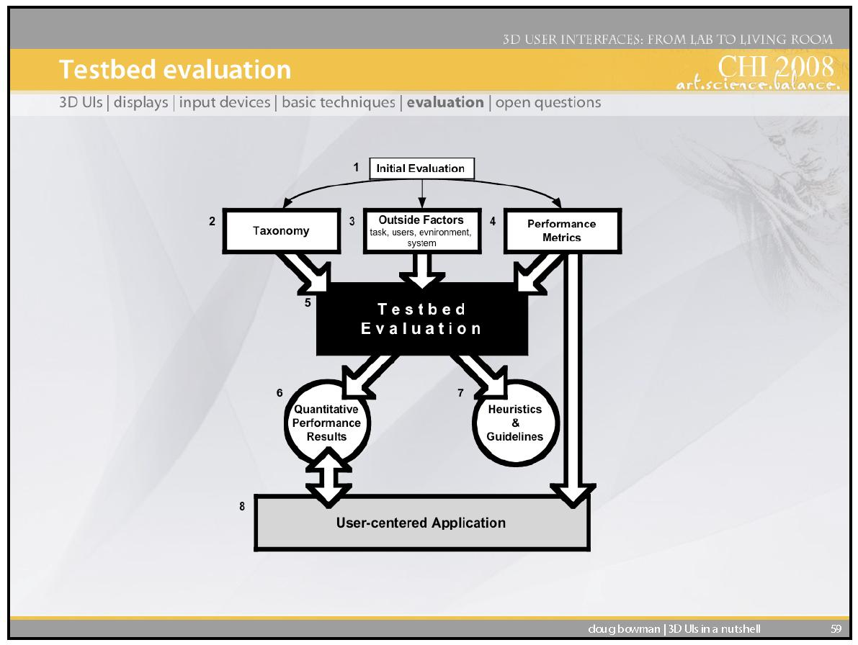
3DUI CW 1 (Group)
3. Planning for CW2 3DUI Interactivity Report (Group Presentation, 1 per group)
c. Commercial Analysis

Slide 52
Module Scope – Working Practice
System/Commercial Analysis:
Games Experience Questionnaire

Slide 53
3DUI CW 1 (Group)
3. Planning for CW2 3DUI Interactivity Report (Group Presentation, 1 per group)
e. Navigation Framework (with mouse and keyboard)
Some Examples are:
coded controller with collision, mouse for camera zoom and object selection
Objects are Waypoints for navigation, with mouse orbit of Waypoint
For more see 3D User Interfaces: Theory and Practice and Lectures

Slide 54
3DUI CW 1 (Group)
3. Planning for CW2 3DUI Interactivity Report (Group Presentation, 1 per group) (cntd…)
f. Interactivity (Selection and Manipulation, Triggers with mouse and keyboard)
Some Examples are:
3D Interaction – Unity UI 2D Buttons/Menus in 3D World Space
3D Interaction - Mouse interaction directly with object via 3D Gimbal
2D Interaction – Unity UI 2D Heads Up Display
State changes/Triggers with keyboard
Collisions
For more see 3D User Interfaces: Theory and Practice and Lectures
g. Animation, Movement, Narrative
Some Examples are:
Figure and non-figure Animation, Triggered and Narrative
Transforms and Scripted Movement or Interaction
Investigate Unity Options

Slide 55
3DUI CW 1 (Group)
3. Planning for CW2 3DUI Interactivity Report (Group Presentation, 1 per group) (cntd…)
g. Lighting, Shaders, and Texturing
Examples: Provisional Plans based on work and learning so far
Investigate Unity Options - URP - Universal Render Pipeline
h. Discuss 3D UI Efficacy
Conceptual Control to Task mapping
Perceptual structure, cognitive load and any disconnect
Motor coordination and any tiring or clash

Slide 56
3DUI CW 1
Remember – CW1 is initial planning – Group Report (3)
Overview
Research/Reference
Problem, Project Concept
3DUI Theory and concepts used
b. Design – (Diagrams, MVC)
Storyboard/Flowchart
Use Case Diagram
Domain/Class Diagram
c. Project Methodology
Agile, Extreme, Waterfall, Spiral
d. Commercial Analysis
Current/Future Requirements, Theory, Commercial Issues, UI Sentiment
Interactivity (Selection and Manipulation)
Animation, Movement, Narrative
Lighting, Shaders, Texturing
UI Efficacy

Slide 57
3DUI CW 2
Remember – CW1 is initial planning - Individual Report (2)
Individual contributions
Group Contributions
Rendered Images of above
Any details that present your work within the group and help me mark you.

Slide 58
3DUI CW 2
Clarification – CW2 is implementation – Individual Report for CW2, no Group report
Individual contributions
Group Contributions
Project Management Methodology and results
Commercial viability
Storyboard/Flowchart, Basic Use Case Diagram, Basic Domain/Class Diagram (final)
Navigation Framework
Interactivity (Selection and Manipulation)
Animation and Movement
Lighting, Shaders, Texturing
Discussion of UI Efficacy
i. Conceptual Control to Task mapping
ii. Perceptual structure, cognitive load and any disconnect
iii. Motor coordination and any tiring or clash

Slide 59
3DUI CW 1 (Group)
4. Group Contributions
Group Padlet, linked to blackboard and including all group and individual renders
Group BB area
Video blogs in Padlet
Presentations in class
Meeting minutes or notes
Work in Progress Video for 4 Nov
Peer review Video with comments on other groups' work

Slide 60
3DUI Unity
Unity 3D UI
Start to think about Unity UI
https://www.youtube.com/watch?v=JrlFMwLI1fw
https://unity3d.com/learn/tutorials/topics/user-interface-ui
https://docs.unity3d.com/Packages/com.unity.ugui@2.0/manual/index.html

Slide 61
References
3D User Interfaces: Theory and Practice
Doug A. Bowman, Ernst Kruijff, Joseph J. LaViola, Ivan Poupyrev
Addison Wesley Longman Publishing
USA
The Three-Dimensional User Interface
Hou Wenjun
Beijing University of Posts and Telecommunications
China

